Slide 1

Income Prediction
Supervised Machine Learning with
2019 Census Data

Slide 2
What Value?
Identifying higher income customers has many benefits across several industries.
•Personalize an offer or product, exposure to premium products.
•Targeted marketing cost savings
•As a customer’s income is not always explicitly known, a predictive model uses other available information.

Slide 3
Dataset & Overview
Annual Social and Economic Supplements 2019
This Annual Social and Economic (ASEC) Supplement provides the usual monthly labor force data, but in addition, provides supplemental data on work experience, income, noncash benefits, and migration. Comprehensive work experience information is given on the employment status, occupation, and industry of persons 15 years old and over. Additional data for persons 15 years old and older are available concerning weeks worked and hours per week worked, reason not working full time, total income and income components. Data on employment and income refer to the preceding year, although demographic data refer to the time of the survey.
This file also contains data covering nine non-cash income sources: food stamps, school lunch program, employer-provided group health insurance plan, employer-provided pension plan, personal health insurance, Medicaid, Medicare, or military health care, and energy assistance. Characteristics such as age, sex, race, household relationship, and Hispanic origin are shown for each person in the household enumerated.

Slide 4


Dataset & Overview
Individual Records
•Data complexity
•Challenges posed by dataset

Slide 5
Project Flow
Exploration
Feature Selection/ Engineering
Modeling
Model Tuning
Cleaning the data, removing unnecessary elements.
Narrowing data to scope of project
Metrics based selection using correlation of features to target.
Combining of highly correlated features.
Using both Random Forest and Light Gradient Boosted modeling.
Iterated to select best features.
Testing for and assigning optimized hyperparameters.

Slide 6
Loading & Cleaning the Data
Removed:
• unnecessary Record Identifiers and Weights columns
• allocation flag columns
• unnecessary and redundant columns
• persons under 18 years old as they are outside the scope

Slide 7
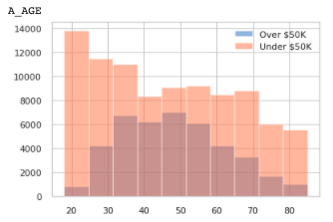
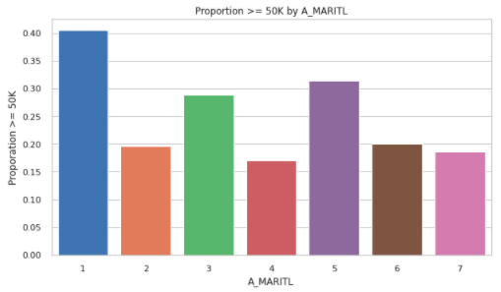
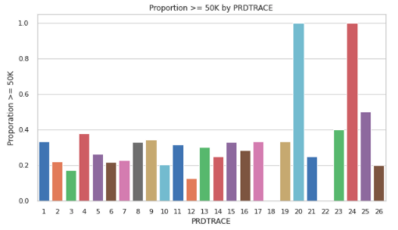
Data Exploration
Personal Characteristics

Slide 8
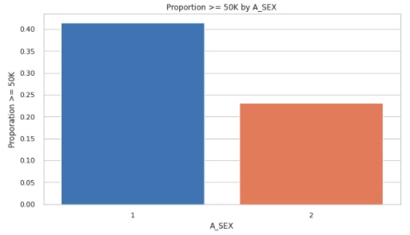
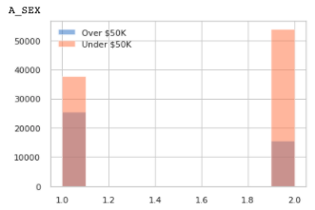
Data Exploration
Gender

Slide 9
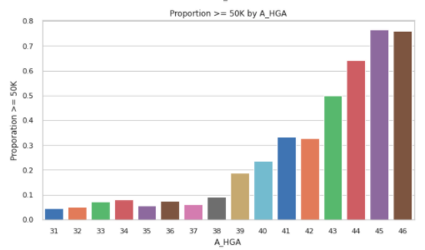
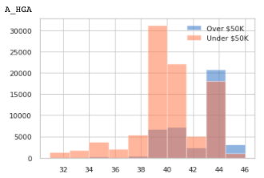
Data Exploration
Education

Slide 10
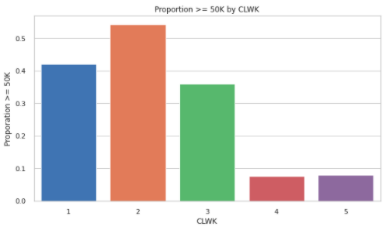
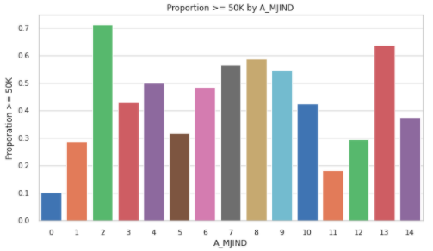
Data Exploration
Worker Class & Industry

Slide 11
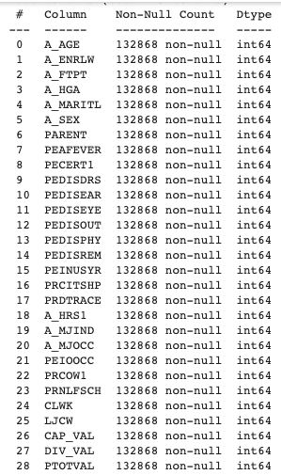
Initial Feature Selection
Why not include everything?
Prominence of categorical features
Details from iterations of feature selection

Slide 12
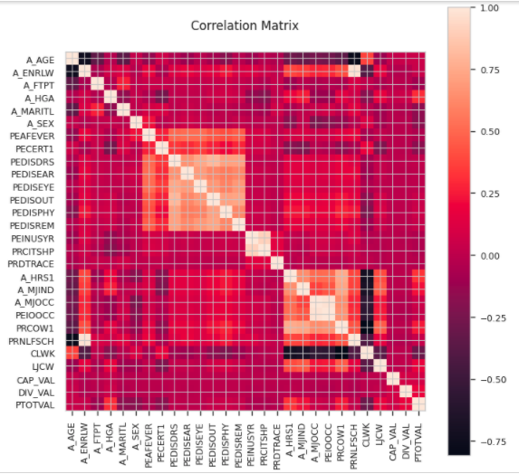
Initial Feature Selection
Narrowed feature correlation heatmap
High correlation between PEDI features
High correlation between Industry features

Slide 13
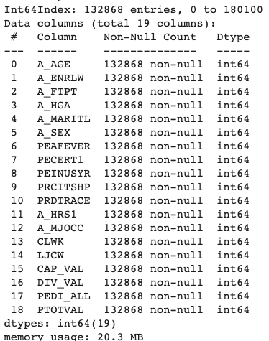
Final Feature Selection
Removed some highly correlated features
Engineered a feature to combine some of those correlated.
Total of 111 columns with dummies added.

Slide 14
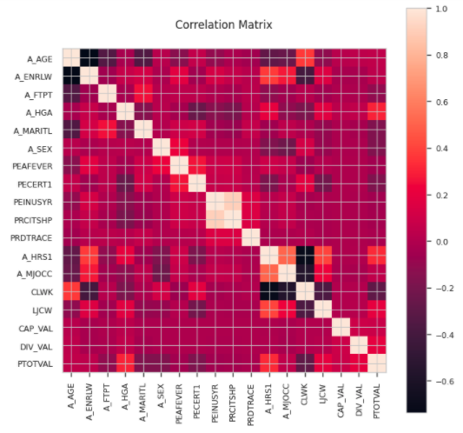
Final Feature Selection
Some correlated features remain as removing or engineering replacements did not improve model performance.

Slide 15
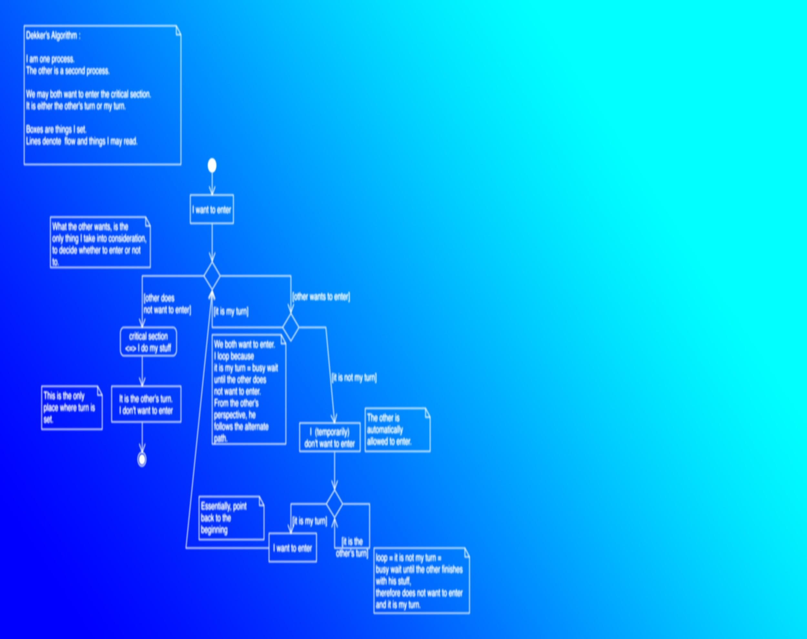
Modeling

Slide 16
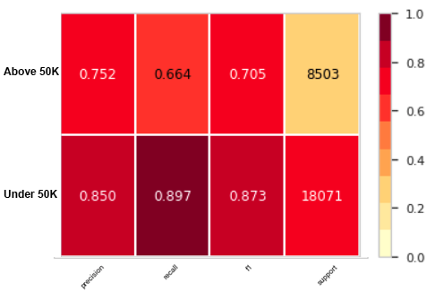
Random Forest
Good performance for <50K
Poor recall for >50K
ROC_AUC score: 0.8664
F-score: 0.6842
Log Loss: 0.6068
Tuned
ROC_AUC score: 0.8903
F-score: 0.7055
Log Loss: 0.3842

Slide 17
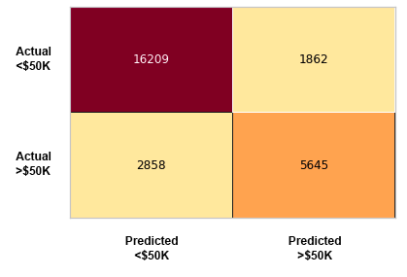
Random Forest
33% of targets misidentified
10% False Positive

Slide 18
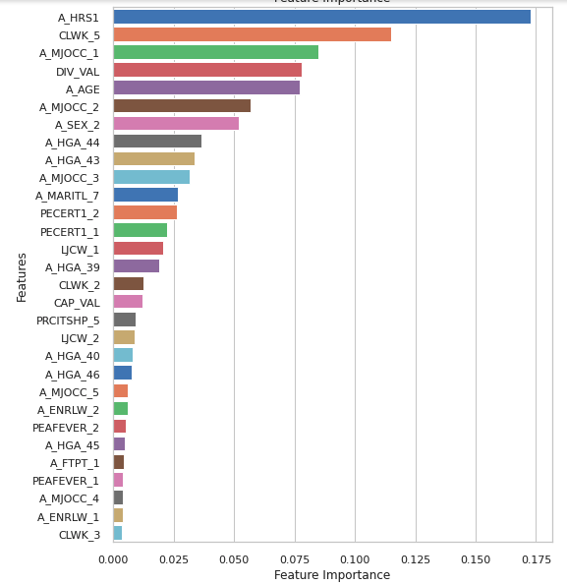
Random Forest
The ten most important features are:
Hours worked per week
Longest job class of worker
Major occupation sector
Dividends from stocks or mutual funds
Age
Gender
Education

Slide 19
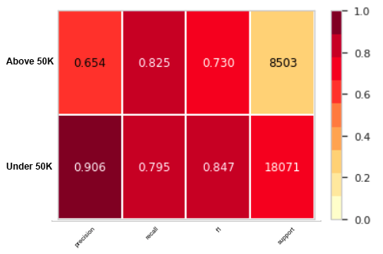
Light Gradient Boosted
Poor precision but better recall for >50K
Overall better F1 for >50K from RF
ROC_AUC score: 0.8924
F-score: 0.7093
Log Loss: 0.3794
Tuned
ROC_AUC score: 0.8940
F-score: 0.7295
Log Loss: 0.4106

Slide 20
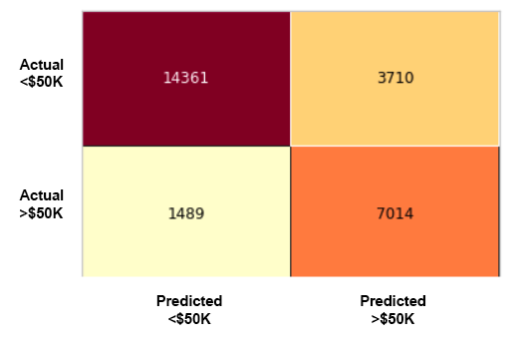
Light Gradient Boosted
17.5% of targets misidentified
20% False Positive
For most use cases this is an improvement from the RF model

Slide 21
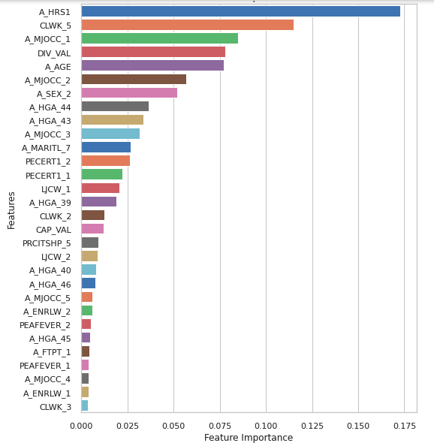
Light Gradient Boosted
The ten most important features are:
Hours worked per week
Longest job class of worker
Major occupation sector
Dividends from stocks or mutual funds
Age
Gender
Education
The same features as the RF model

Slide 22
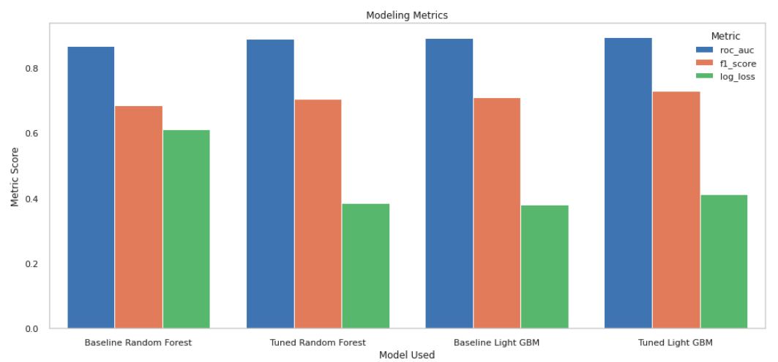
Model Comparison
The Light GBM model is superior, but the increase in performance is small.

Slide 23
Conclusion
Using LGBM is a reasonably reliable way to predict income.
Models based on the information available to the client are feasible even with a small feature set.

Slide 24

Questions?

